Slide 1
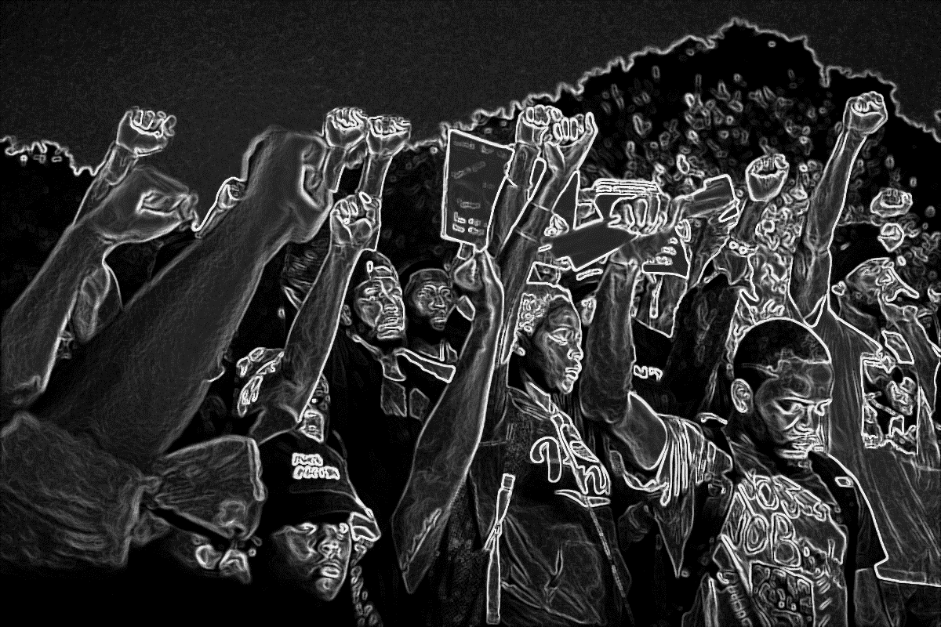
Black Lives Matter Social Justice
Analytics Dream Team
Adriana Ortiz Enzo Migliano Juan Zambrano

Slide 2
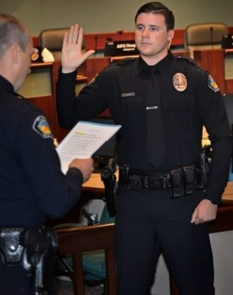
Problem Statement
Under the research question: Are African-American threaded harsher in the American Society?
Our team developed several hypothesis on the spectrum of education, law inforcement and others

Slide 3
Analytics Purpose & Motivation
Statistics and hard facts
Jurors are more likely to give the death penalty in cases in which African American Defendants are accused of killing [1].
Unarmed African Americans are 3.5 more likely to be shot by police than unarmed Caucasian [2].
Up to March of 2017, 47% of all exonerations of wrongfully convicted people were African Americans while making up only 13% of the United States Population [3]
African Americans are 6 times more likely than Caucasians to be victim of a homicide (African Americans 19.6 homicides per 100,000, Caucasians 3.3 homicides per 100,000) [4].

Slide 4
Data: What are your data sources?
2010&2011_Vadir_NY
2011&2012_Vadir_NY
2012&2013_Vadir_NY
All_Illnesses_Deaths_rate
Chicago_Crime
Contract_Police
Covid_Deaths_Race
Dallas_Arrests
Education_Census
Employment_FBI
Equipment_police
Housing
Juvenile_Arrests
LA_Crime
NY_StopFrisk_2015
NY_StopFrisk_2016
NY_StopFrisk_2017
NYPD_Arrests
Police_Budget
Politics
Poverty Census
Washington Post Shootings

Slide 5
Data: What does your data look like and its structure?
1. What does your data look like and its structure?
Our data came in a structured format – CSV
We had similar data sets such a year by year of NY_StopFrisk. Reports changed both in variables and names as years progressed from 2015 to 2017.
Tidying process was long to align data different data frames together.
Data sets were not very constant with assigning values
Dates and times columns were different in each case

Slide 6
Data: What Percentage of the data you use?

Slide 7
Data Preparation
NY_StopFrisk
Selected relevant variables to our investigation
Renamed variable into more understandable and visual names
Merged data sets into one (NY_StopFrisk2)
Vadir_NY
Merged all historical data from 2010 to 2013
Selected relevant variables to our investigation
Remaining Data Sets were Tidy

Slide 8
Explain: Exploratory Analysis
We explored the data by using the function view and summaries.
In the process of tidying we got really familiarized with the data
Utilized data that made the most sense for our investigation while attempting to provide an analysis in a timely manner

Slide 9
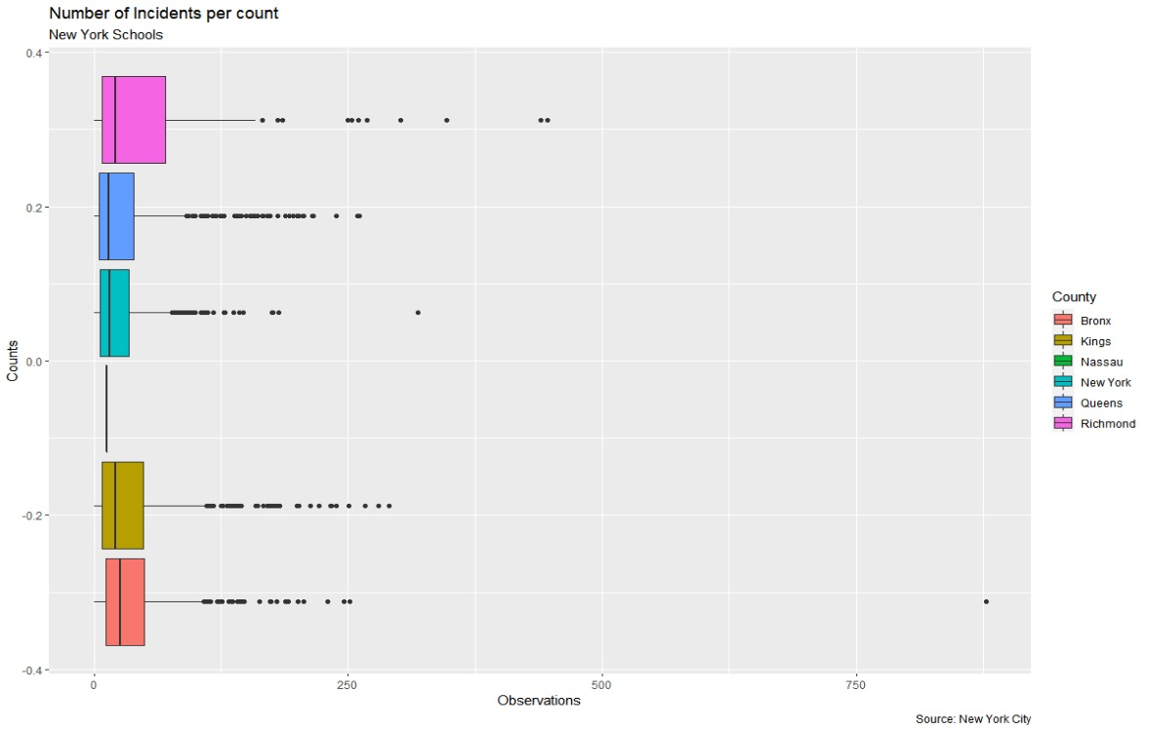
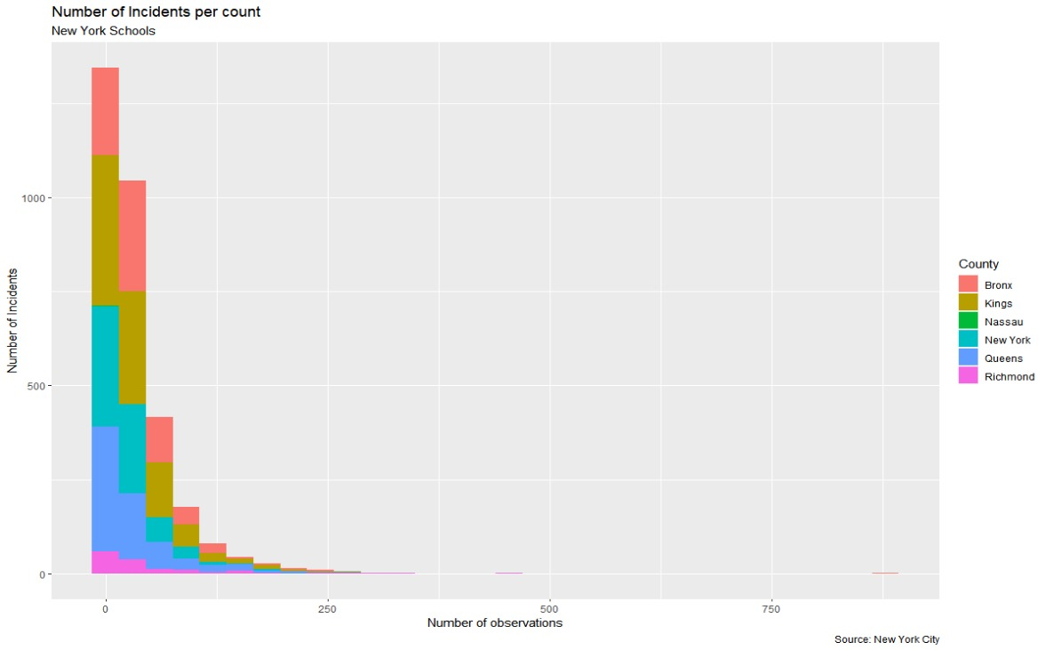
Explain: Hypothesis Analyses
In New York incidents in schools happen significantly more frequent in neighborhoods were there more African Americans.
2. Is there a significant difference between the injuries with weapons in Richmond and Bronx?

Slide 10
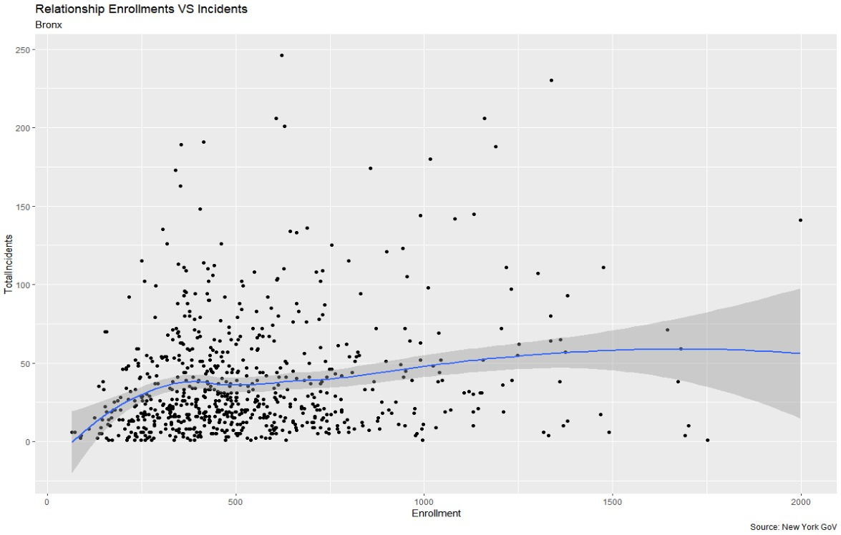
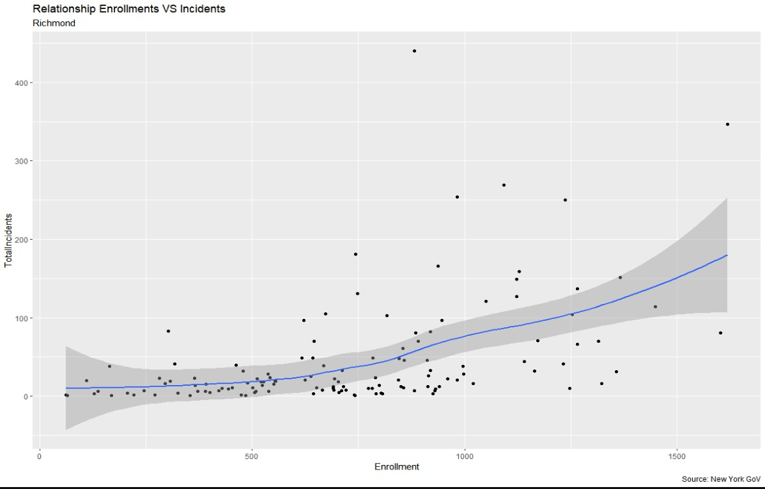
How and Why: Regression
Non-Linear Regression
Loess Model: Independent Variable: Enrollment
Dependent Variable: Incidents

Slide 11
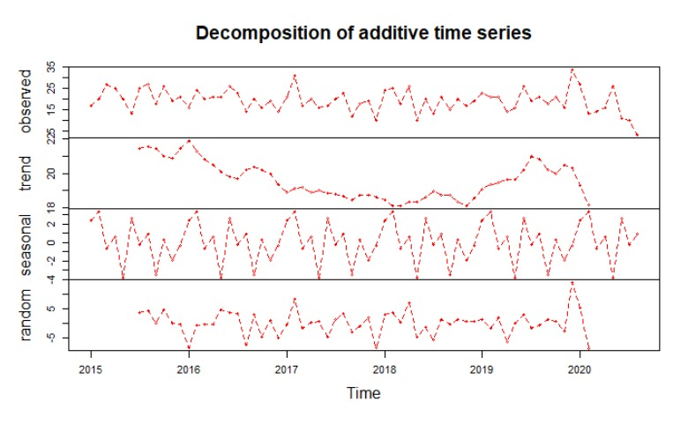
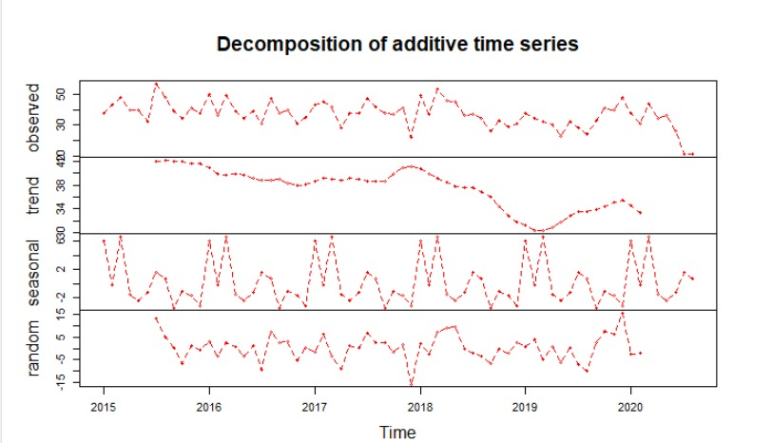
Explain: Time Series Analysis

Slide 12
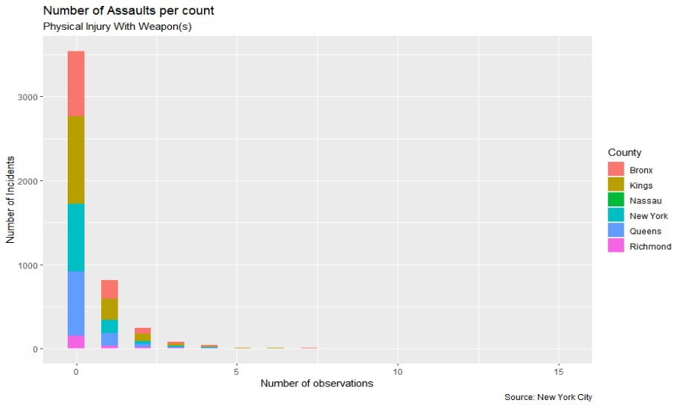
Results: Statistics

Slide 13
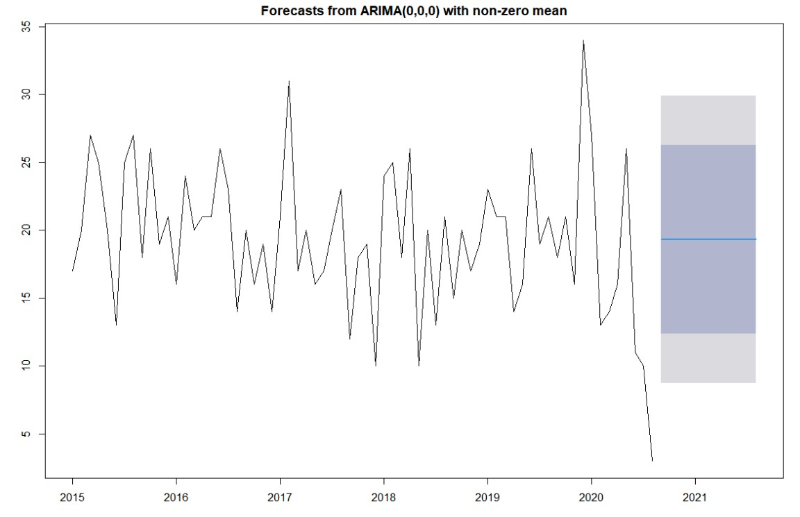
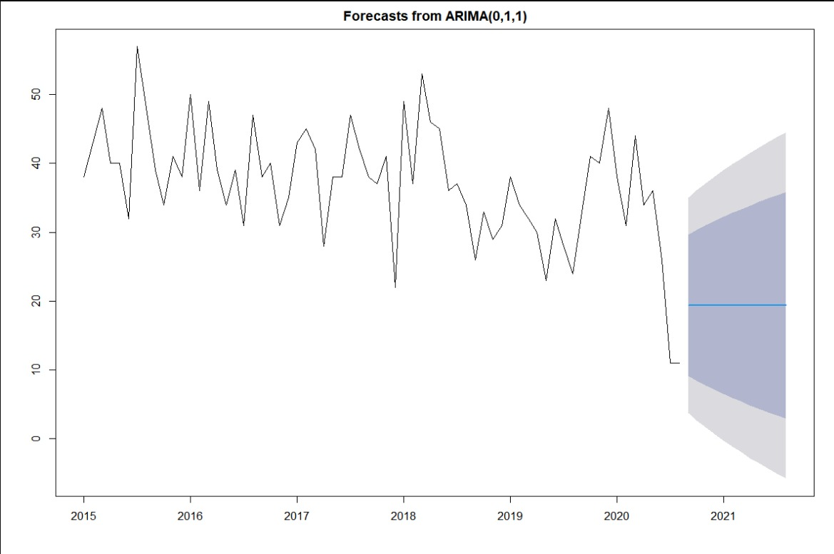
Results: Visualization
Time Series Analyses

Slide 14
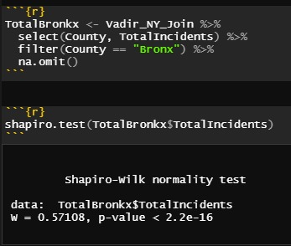
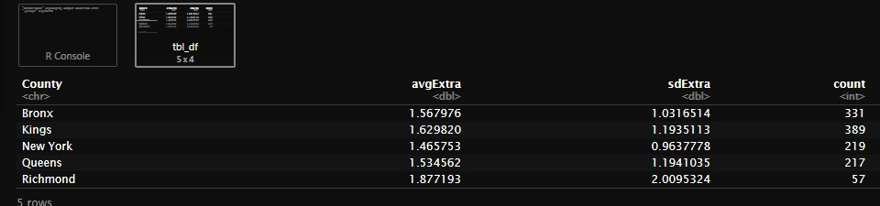
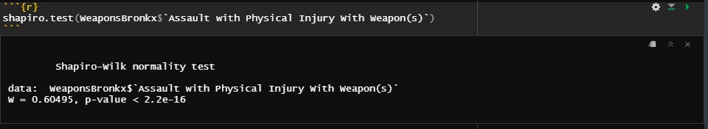
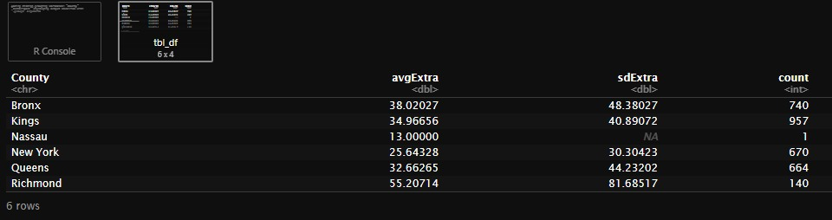
Results: Normality, Standard Deviation & Variance
Hypothesis 1
Hypothesis 2

Slide 15
Results: Hypothesis Testing
Hypothesis Tests Results 1:
There were no significant differences between Bronx and Richmond regarding total indicants. P-vale > a in the WilcoxTest
Hypothesis Tests Results 2:
There were no significant differences between Bronx and Richmond regarding total indicants. P-vale > a in the WilcoxTest

Slide 16
Conclutions
The Black Lives Matter movement is a complexed issue in our society as a whole. Although, our results did not show significant difference in our Hypothesis, the problem in disparity between races is much complex than the analysis available in this study.
In future studies, in order to achieve meaningful results, more complex analysis must be done.

Slide 17
Any Questions?

Slide 18
THANK YOU!
“Keep calm and be significant”
Analytics Dream Team

Slide 19
Bibliography
[1] J. S. Hunt, “Race, ethnicity, and culture in jury decision making,” Annu. Rev. of Law and Social Sci., vol. 11, pp. 269-288, Nov. 2015, doi: 10.1146/annurev-lawsocsci-120814-121723.
[2] C. T. Ross, “A multi-level bayesian analysis of racial bias in police shootings ar the county-level in the United States, 2011-2014,” PLos ONE, vol. 10, no. 11, pp. E0141854, Nov. 2015, doi: 10.1371/journal.pone.0141854.
[3] National Registry of Exonerations, “Race and wrongful convictions in the United States,” 2017. [Online]. Available: https://www.law.umich.edu/special/exoneration/Documents/Race_and_Wrongful_Convictions.pdf
[4] US Department of Justice, “Homicide trends in the United States, 1980-2008,” 2011. [Online}. Available: https://www.bjs.gov/content/pub/pdf/htus8008.pdf
[5] Crime and Enforcement Activity in New York City, 2019. [Online] Available:https://www1.nyc.gov/assets/nypd/downloads/pdf/analysis_and_planning/year-end-2019-enforcement-report.pdf

